Slide 1

Drug Classification

Slide 2
Dataset problem:
This dataset contains information about drug classification based on patient general information and its diagnosis. Machine learning model is needed in order to predict the outcome of the drugs type that might be suitable for the patient.
There are 6 variables in this data set:
4 categorical variables,and
2 continuous variables
#Variable Name #Description #Sample Data
Age Patient Age 23; 47; ...
Sex Gender of patient (male or female) F; M; ...
BP Levels of blood pressure (high, normal, or low) HIGH; NORMAL; LOW; ..
Cholestero Levels of cholesterol (high or normal) 1.4; 1.3; ...
Na_to_K Sodium to potassium ratio in blood 25.355; 13.093; ...
Drug Type of drug DrugY; drugC; ...

Slide 3
Import Libraries:
import warnings
warnings.filterwarnings("ignore")
import pandas as pd
import numpy as np
import matplotlib.pyplot as plt
from matplotlib.colors import ListedColormap
import seaborn as sns
from pandas.api.types import is_string_dtype
from sklearn.preprocessing import StandardScaler
from sklearn.model_selection import train_test_split
from sklearn import metrics
from sklearn.linear_model import LogisticRegression
from sklearn.metrics import classification_report
from sklearn.metrics import cohen_kappa_score
from sklearn.metrics import confusion_matrix
from sklearn.metrics import roc_auc_score
from sklearn.metrics import roc_curve
from sklearn.linear_model import SGDClassifier
import statsmodels
import statsmodels.api as sm

Slide 4
Read Data and Data preprocesing:
data=pd.read_csv(r"C:\Users\umade\Downloads\drug200.csv")
data.head()
data.shape
data.info()
data.dtypes
data.isnull().sum()
data.Drug.value_counts()
data.BP.value_counts()
data.Cholesterol.value_counts()
#splitting features and the target variable
# consider all the columns except 'Drug' using 'iloc'
data_features = data.iloc[:, data.columns != 'Drug']
# consider the target variable
data_target = data.iloc[:, data.columns == 'Drug']
#summary Statistics:
data.describe()
data.describe(include=Object)

Slide 5
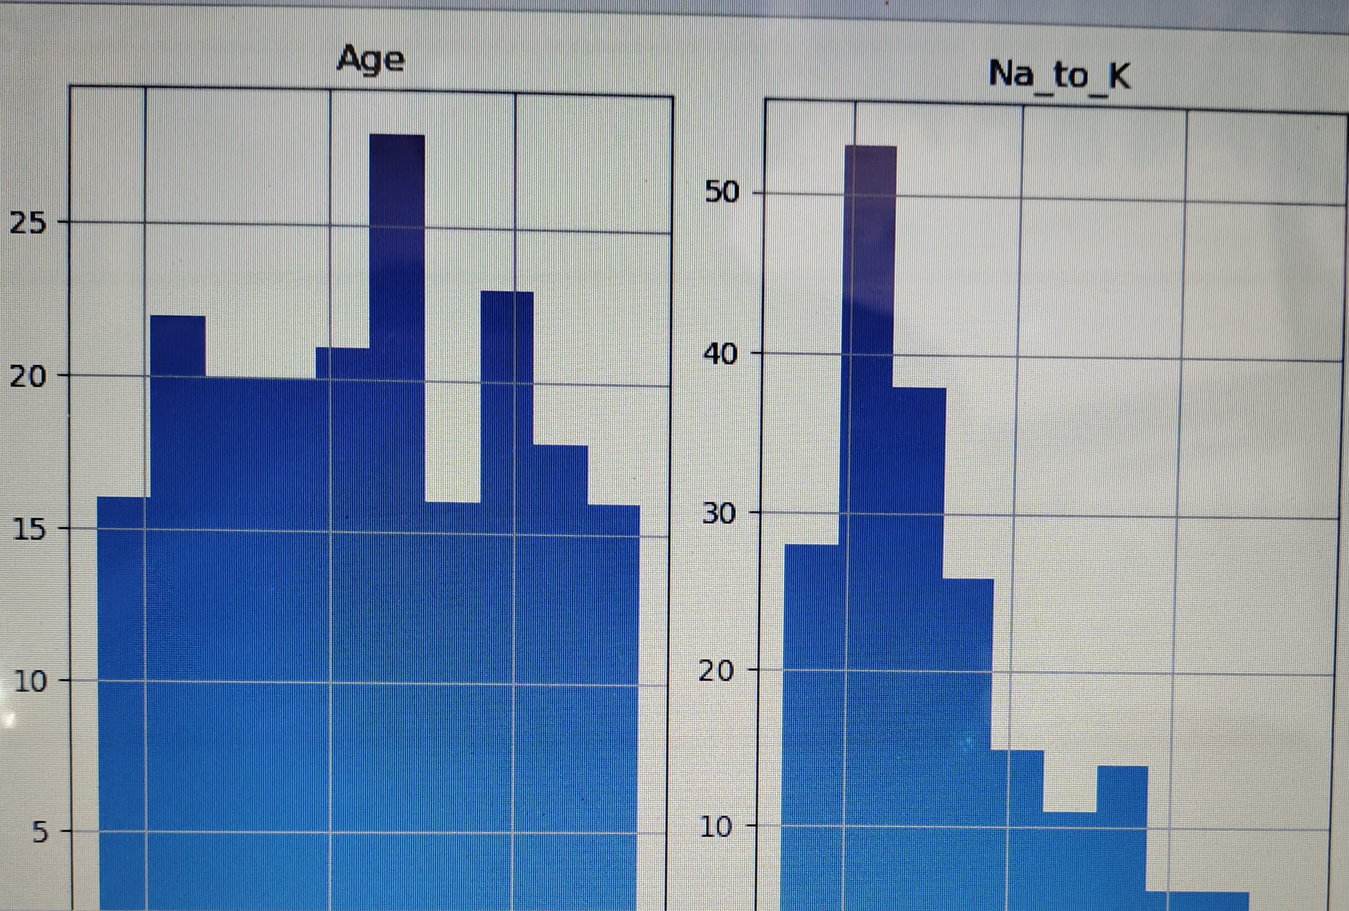
Exploratory Data Analysis:
# we plot histogram using numeric independent varaiables
data_features.hist()
plt.tight_layout
plt.show()

Slide 6
# Distribution of categoric independent variables. For the independent categoric variables, we plot the bar plot to check the distribution of each variables
categorical=[]
for column in data_features
if is_string_dtype(data_features[column]):
categorical.append(column)
fig, ax = plt.subplots(nrows = 3, ncols = 1, figsize=(10, 20))
for variable, subplot in zip(categorical, ax.flatten()):
sns.countplot(data[variable], ax = subplot)
plt.show()

Slide 7
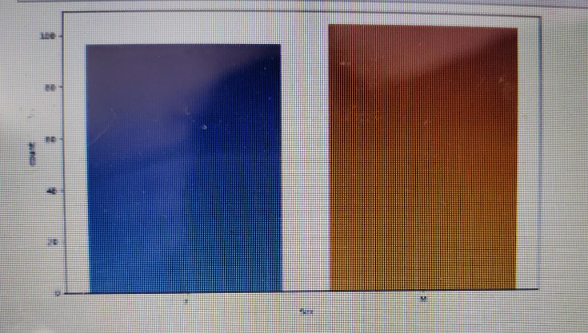
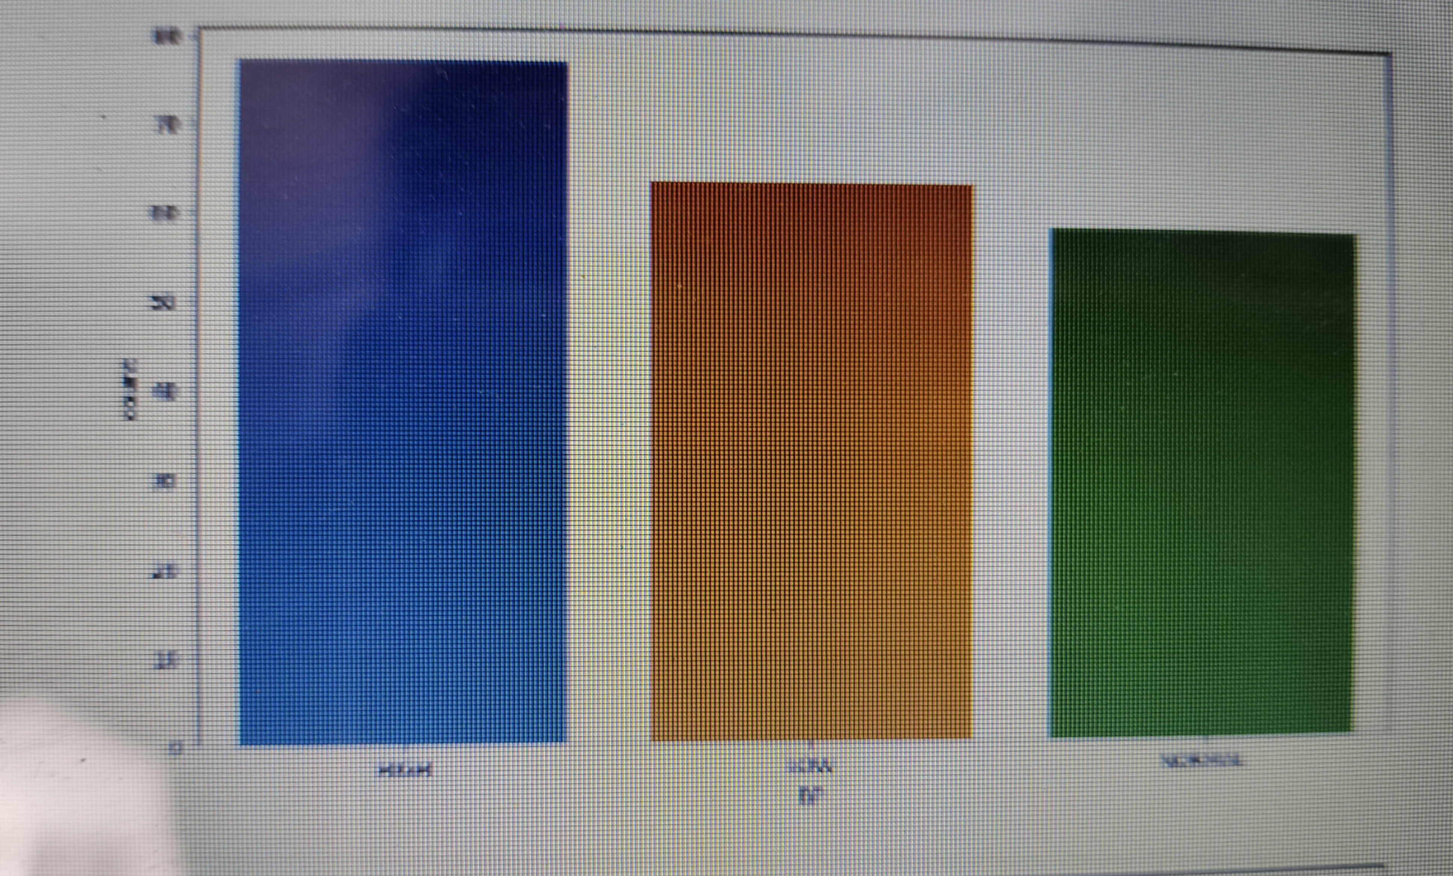
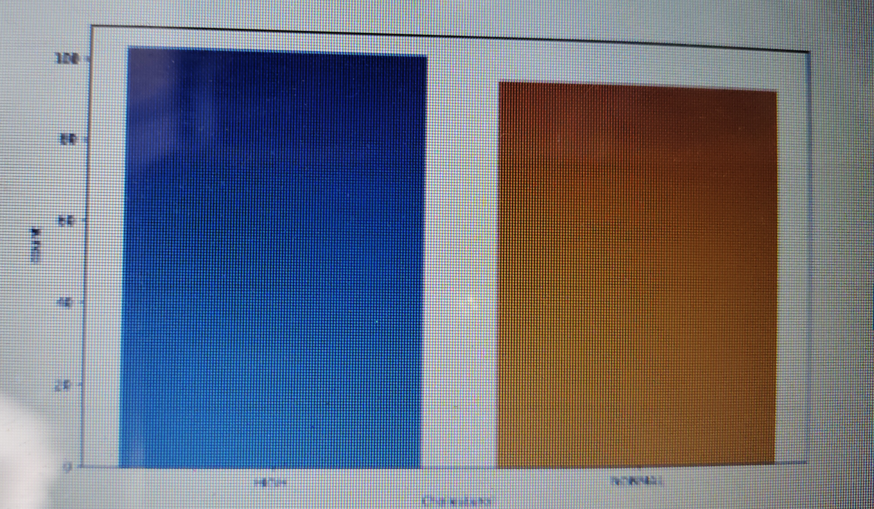

Slide 8
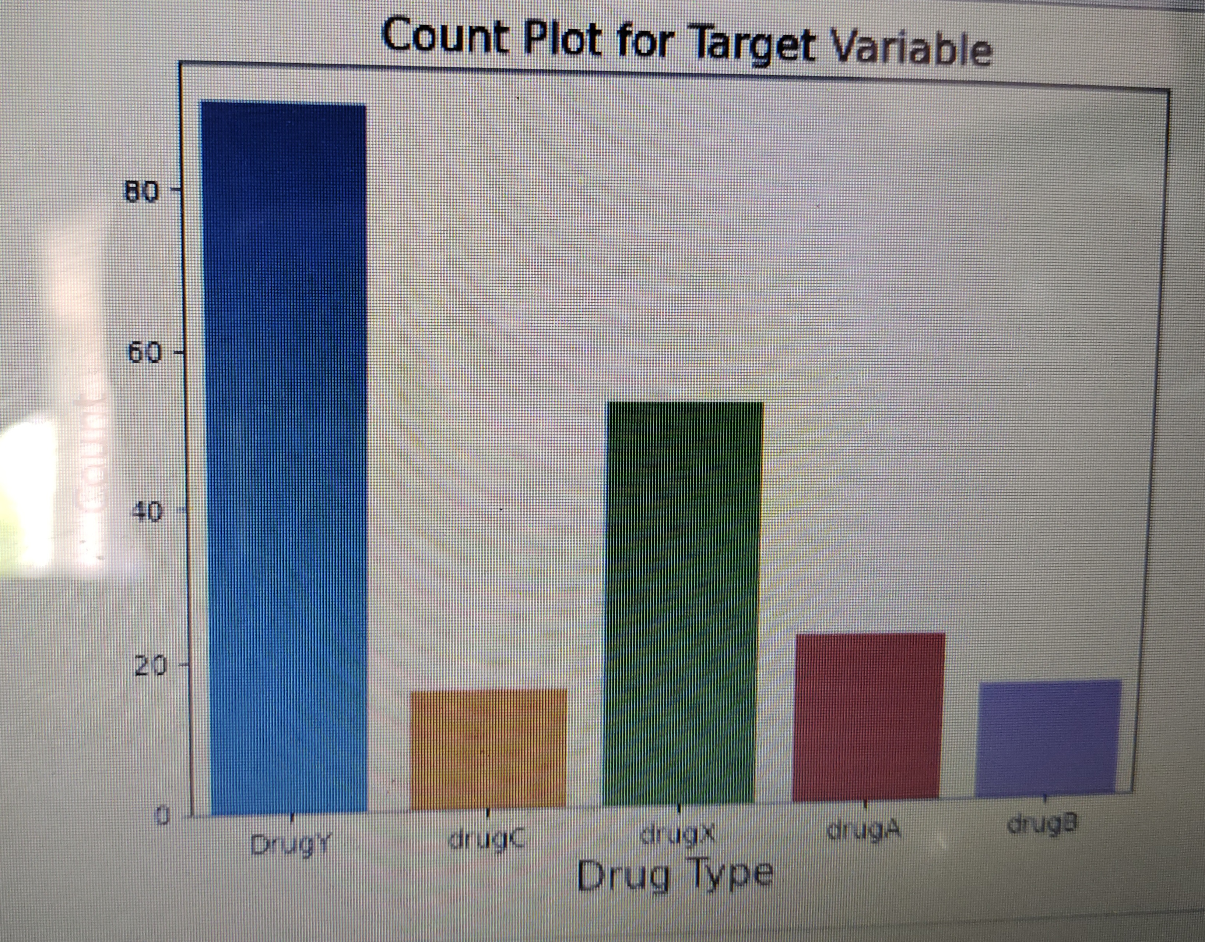
# plot the countplot of the variable 'target'
sns.countplot(data_target.Drug)
# add plot and axes labels
# set text size using 'fontsize'
plt.title('Count Plot for Target Variable', fontsize = 15)
plt.xlabel('Drug Type', fontsize = 15)
plt.ylabel('Count', fontsize = 15)
# to show the plot
plt.show()

Slide 9
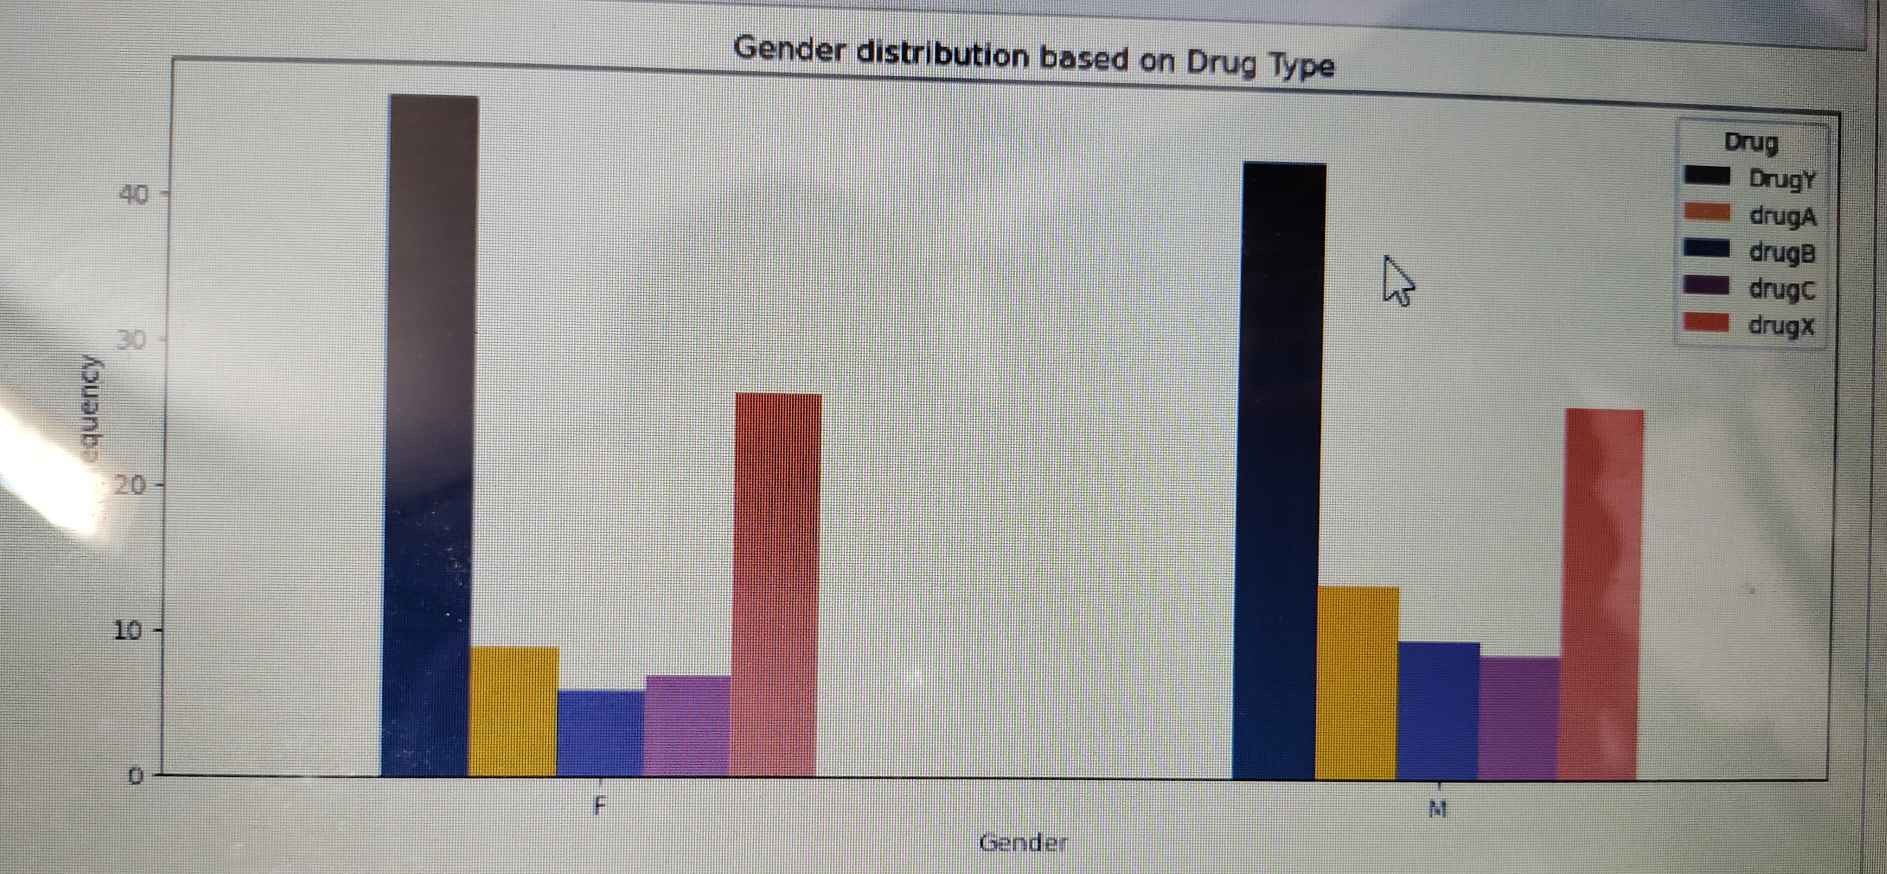
#Gender Distribution Based on the Drug Type.
pd.crosstab(data.Sex,data.Drug).plot(kind="bar",figsize=(12,5),color=['#003f5c','#ffa600','#58508d','#bc5090','#ff6361'])
plt.title('Gender distribution based on Drug Type')
plt.xlabel('Gender')
plt.xticks(rotation=0)
plt.ylabel('Frequency')
plt.show()

Slide 10
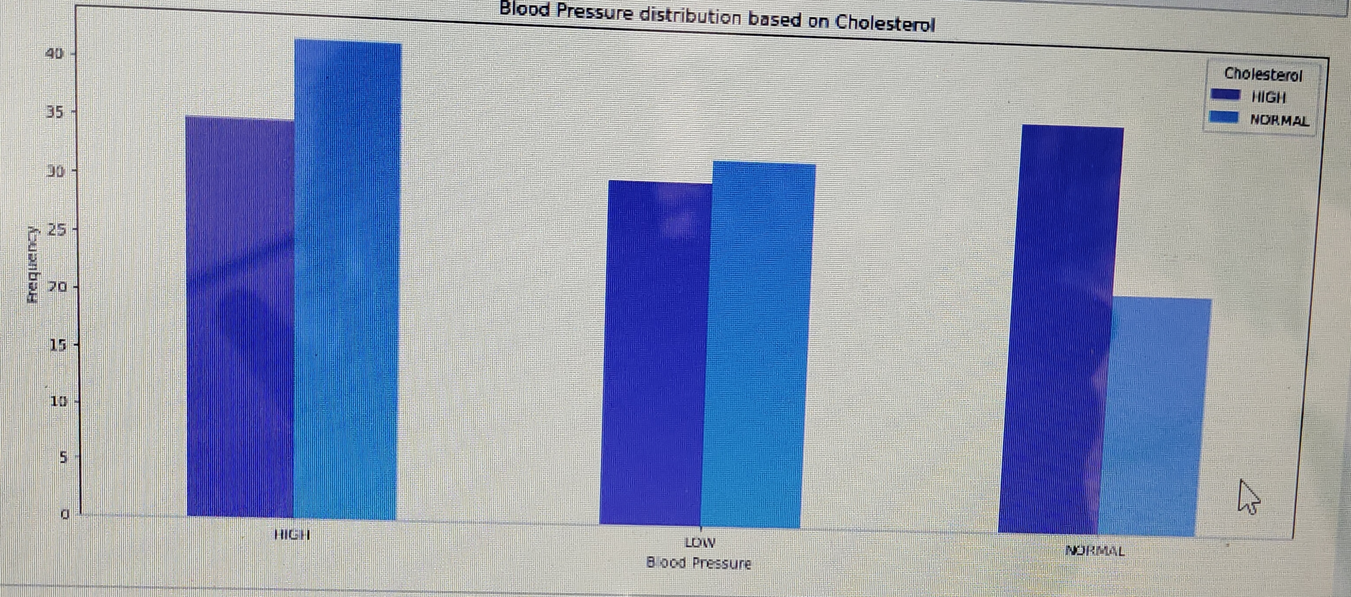
#Blood Pressure distribution based on Cholesterol
pd.crosstab(data.BP,data.Cholesterol).plot(kind="bar",figsize=(15,6),color=['#6929c4','#1192e8'])
plt.title('Blood Pressure distribution based on Cholesterol')
plt.xlabel('Blood Pressure')
plt.xticks(rotation=0)
plt.ylabel('Frequency')
plt.show()

Slide 11
LabelEncoding of Target variable converting target categorical varaiable to numeric.
# replace 'drugA' with zero
data['Drug'] = data['Drug'].replace('drugA', 0)
# replace 'drugB' with one
data['Drug'] = data['Drug'].replace('drugB', 1)
# replace 'drugC' with two
data['Drug'] = data['Drug'].replace('drugC', 2)
# replace 'drugX' with one
data['Drug'] = data['Drug'].replace('drugX', 3)
# replace 'DrugY' with one
data['Drug'] = data['Drug'].replace('DrugY', 4)
data.head()
categorical=[]
for column in data:
if is_string_dtype(data[column]):
categorical.append(column)
data_cat = data[categorical]
data_num = data.drop(categorical, axis = 1)

Slide 12
Dummy encode the categorical variables
# Label encoding is converting the labels into numeric form so as to convert them into machine readble form
# print the first five observations of the 'df_cat'
data_cat.head()
# use 'get_dummies()' from pandas to create dummy variables
# use 'drop_first = True' to create (n-1) dummy variables
data_cat_dummies = pd.get_dummies(data_cat)
data_cat_dummies.head()
# concat the dummy variables with numeric features to create a dataframe of all independent variables
# 'axis=1' concats the dataframes along columns
data_dummy = pd.concat([data_num, data_cat_dummies], axis=1)
# display first five observations of the dummy dataframe
data_dummy.head()
# select only the target variable 'Drug' and store it in dataframe 'y'
y = pd.DataFrame(data_dummy['Drug'])
#Now, use this 'y' as a target variable to build the classification models.
X = data_dummy.drop('Drug',axis = 1)
X.head()
#Use this 'X' as a set of predictors to build the classification models.

Slide 13
Standardize data:
from sklearn.preprocessing import StandardScaler
scaler = StandardScaler()
scaler.fit(X)
X = scaler.fit_transform(X)
# create a generalized function to calculate the metrics values for test set
def get_test_report(model):
# return the performace measures on test set
return(classification_report(y_test, y_pred))
# create a generalized function to calculate the metrics values for test set
def kappa_score(model):
# return the kappa score on test set
return(cohen_kappa_score(y_test, y_pred))

Slide 14
1.Logistic Regression
Logistic regression is one of the techniques used for classification. The estimates of the parameters are obtained by maximizing the likelihood function.
X_train, X_test, y_train, y_test = train_test_split(X, y, test_size = 0.30, random_state = 10)
print("X_train",X_train.shape)
print("y_train",y_train.shape)
print("X_test",X_test.shape)
print("y_test",y_test.shape)
Logit_Model = LogisticRegression()
Logit_Model.fit(X_train,y_train)
y_pred = Logit_Model.predict(X_test)
y_pred
from sklearn.metrics import classification_report, accuracy_score
Score = accuracy_score(y_test,y_pred)
Score is 0.9166666
test_report = get_test_report(Logit_Model)
# print the performace measures
print(test_report)
kappa_value = kappa_score(Logit_Model)
print(kappa_value) is 0.8865

Slide 15
2.Decision Tree
X_train, X_test, y_train, y_test = train_test_split(X, y, test_size = 0.30, random_state = 10)
#Build a decision tree classifier
from sklearn.tree import DecisionTreeClassifier
# Creating a decision tree classifier
clf_entropy = DecisionTreeClassifier(criterion = "entropy", random_state = 10, max_depth = 3,
min_samples_leaf = 5)
# Training the model
clf_fit = clf_entropy.fit(X_train, y_train)
# Predicting
y_pred = clf_fit.predict(X_test)
from sklearn.metrics import accuracy_score
accuracy_score(y_test, y_pred) is 85%

Slide 16
Perform Hyperparameter Tuning
#Perform hyperparameter tuning:
clf_gini = DecisionTreeClassifier(criterion = "gini", random_state = 20, max_depth = 4,
min_samples_leaf = 10)
# Training the model
clf_fit_2 = clf_gini.fit(X_train, y_train)
# Predicting the chance of admission
y_pred_2 = clf_fit_2.predict(X_test)
from sklearn.metrics import accuracy_score
accuracy_score(y_test, y_pred_2) is 88%
print(classification_report(y_test, y_pred_2))
We can see here that by changing the values of the parameter, there is a slight increase in the accuracy. Earlier we were using 'Entropy' as criterion, now we are using 'Gini' as criterion, the max depth of the tree has been increased and so on. Similarly, we can keep on tuning the parameters, to obtain the highest accuracy.

Slide 17
3.Random Forest
from sklearn.ensemble import RandomForestClassifier
#intantiate the classifier
rf_clf = RandomForestClassifier(n_estimators=100, random_state=10)
# fit the classifier with training dataset
rf_clf.fit(X_train, y_train)
# predict the values on test dataset using predict()
y_pred = rf_clf.predict(X_test)
print(classification_report(y_test, y_pred))
Accuracy is 98%

Slide 18
4.KNN Model
X_train, X_test, y_train, y_test = train_test_split(X, y, test_size = 0.30, random_state = 10)
from sklearn.metrics import confusion_matrix
from sklearn.model_selection import GridSearchCV
from sklearn.neighbors import KNeighborsClassifier
knn_classification = KNeighborsClassifier(n_neighbors = 3)
# fit the model using fit() on train data
knn_model = knn_classification.fit(X_train, y_train)
test_report = get_test_report(knn_model)
print(test_report) is 98%

Slide 19
5.SVM Model
Support Vector Machine using Linear Kernal
X_train, X_test, y_train, y_test = train_test_split(X, y, test_size = 0.30, random_state = 10)
from sklearn.svm import SVC
# build the model
svclassifier = SVC(kernel = 'linear')
# fit the model
svclassifier.fit(X_train, y_train)
y_pred = svclassifier.predict(X_test)
# accuracy measures by classification_report()
result = classification_report(y_test,y_pred)
# print the result
print(result) is 93%
Support Vector Machine using Gaussian Kernal
svclassifier = SVC(kernel = 'rbf')
svclassifier.fit(X_train, y_train)
y_pred_gaussian = svclassifier.predict(X_test)
result = classification_report(y_test, y_pred_gaussian)
print (result) is 78%

Slide 20
Support Vector Machine using Sigmoid Kernal
# build the model
svclassifier = SVC(kernel='sigmoid')
# fit the model
svclassifier.fit(X_train, y_train)
y_pred_sigmoid = svclassifier.predict(X_test)
result = classification_report(y_test,y_pred_sigmoid)
print(result) is 85%
Support Vector Machine using Polynomial Kernal
# build the model
svclassifier = SVC(kernel='poly')
# fit the model
svclassifier.fit(X_train, y_train)
y_pred_Poly = svclassifier.predict(X_test)
result = classification_report(y_test, y_pred_Poly)
print(result) is 72%

Slide 21
Results:
# Model Name: Accuracy score:
Logistic Regression 92%
Decision Tree 85%
Decision Tree (Tuning) 88%
Random Forest 98%
KNN Model 98%
SVM(Linear Kernal) 93%
SVM (Gaussian Kernal) 78%
SVM (Sigmoid Kernal) 85%
SVM(Polynomial Kernal) 72%

